Slide 1


Enron
Riham, Terry, JASON, Annanya

Slide 2

Enron HISTORY
A U.S. energy, commodities, and services company that traded derivative contracts for a wide variety of commodities—including electricity, coal, paper, and steel—and even for the weather
Due to increased competition in the energy-trading business, company executives began to rely on dubious accounting practices allowed the company to write unrealized future gains from some trading contracts into current income statements, thus giving the illusion of higher current profits.
At Enron's peak, its shares were worth $90.75; when the firm declared bankruptcy on December 2, 2001, they were trading at $0.26.

Slide 3
approach 1- Anomaly detection
Objective: Identify fraudulent employees using Enron dataset
Built a classification algorithm to predict a person of interest identifier (POI) based on financial details available in the dataset.
POI: Anyone who has been indicted, settled without admitting the guilt and testified in exchange for immunity. We will check our predicted POI against actual POI in the dataset to evaluate our prediction.

Slide 4
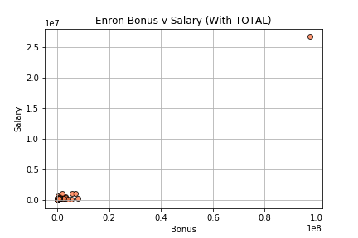
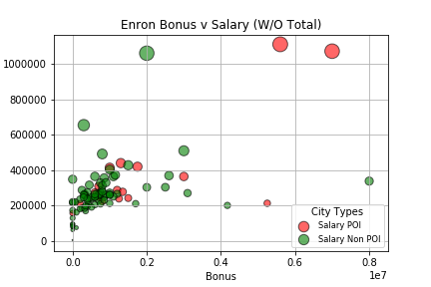
Data Exploration
Dataset included a list 146 contacts
Identified 18 Person-Of-Interest based on financial features from the dataset
Kenneth Lay
Jeffrey Skilling
Mark Frevert

Slide 5
Data Cleansing
Null data originally in the file as NaN
Two extraneous rows, “TRAVEL AGENCY IN THE PARK” AND “TOTAL” dropped from dataset as they do represent persons of interest.
Determined that NaN represented a 0 value. I.E. NaN in exercised_stock_options meant the employee exercised no stock options.
Converted NaN values to numeric “0” in order to run the models.
Name and Email_Address fields needed to be dropped from the dataset to run the models.
Data split into two:
Numeric – All employees (minus “Travel Agency” and “Total”) with NaN values represented as “0”
Trimmed – Employees who had at least 70% of the fields as non-NaN values

Slide 6

Machine learning Models

Slide 7
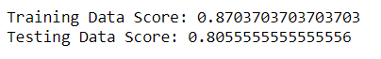
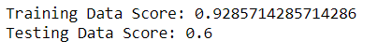
Linear regression
Full Dataset
Trimmed Dataset
The full dataset does not train as well as the trimmed dataset, but outperforms on the testing model
The trimmed dataset over-trains the model and results in a poor testing score

Slide 8
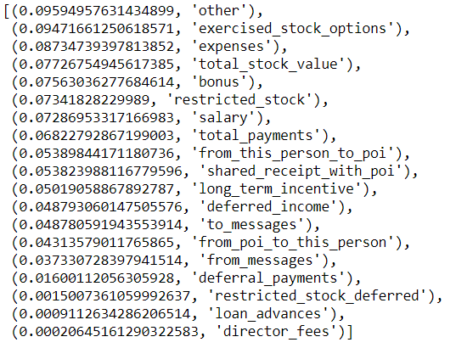
Random Forest
Full dataset:
144 ‘real’ employees
A random forest model on the full data placed a different emphasis than the trimmed dataset
All three of the values selected were are more common forms of compensation for executive level employees
Identified the following features with the strongest coefficient when using random forest classifier to predict feature importance:
Other
Exercised_Stock_Options
Expenses

Slide 9
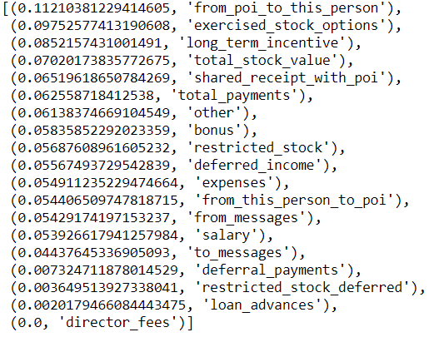
Random Forest
Trimmed Data:
People who had more than 70% of the data =/ null
The trimmed dataset more heavily skews towards executives , as they were more likely to have more non null values in this dataset
The trimmed dataset shows that the communication between POI’s becomes the most important indicator of wrong-doing.
Identified the following features with the strongest coefficient when using random forest classifier to predict feature importance:
From_POI_to_this_Person
Exercised_Stock_Options
Long_Term_Incentive

Slide 10
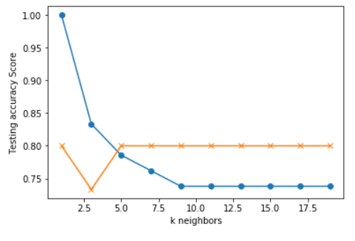
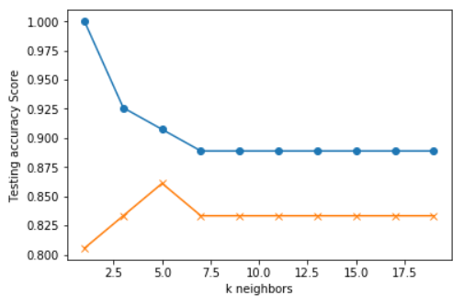
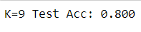
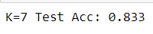
K Nearest Neighbor
Trimmed Data
Numeric Data

Slide 11
Conclusions
The “Numeric” or complete dataset provided better results than the “Trimmed” dataset
Trimmed honed in too much on POI’s and resulted in over-training the model
The models provide a strong foundation to on which to identify potential POI’s, but cannot be used as a definitive predictor of corporate misbehavior.
Additional employee data would likely improve the accuracy of the model. We were restricted to 144 employees, which did not provide enough data for our models to fully train.

Slide 12
APPROACH II- SOCIAL network analyst (SNA)
Objective: Utilize emails from the Enron investigation that has been made public.
Original hypothesis: The SNA should identify the same employees from the anaolmy detection.
The SNA was based on the number of emails sent from Enron employees. A Python library called Networkx was utilized for the SNA.

Slide 13
Data exploration
CSV file contained over 500,000 emails from 150 key Enron staff.
Emails were also stored in a SQL database as well (this database is publicly available).
The large CSV file resulted in 2 approaches to run the model on the data:
Approach 1- Chunk Size of 10,000 rows.
Approach II- Random Sample of 500

Slide 14
Data cleansing
Each row in the CSV had the same pattern. This allowed us to write for loops to spilt the rows and store the data.
4 loops were used to clean the data:
Spilt the message of the email from the rest of the row
Store the message into a specific dataframe
Spilt the email address from the message
Drop rows that did not follow the above format for data purity
22% of emails were dropped as a result of this loop

Slide 16
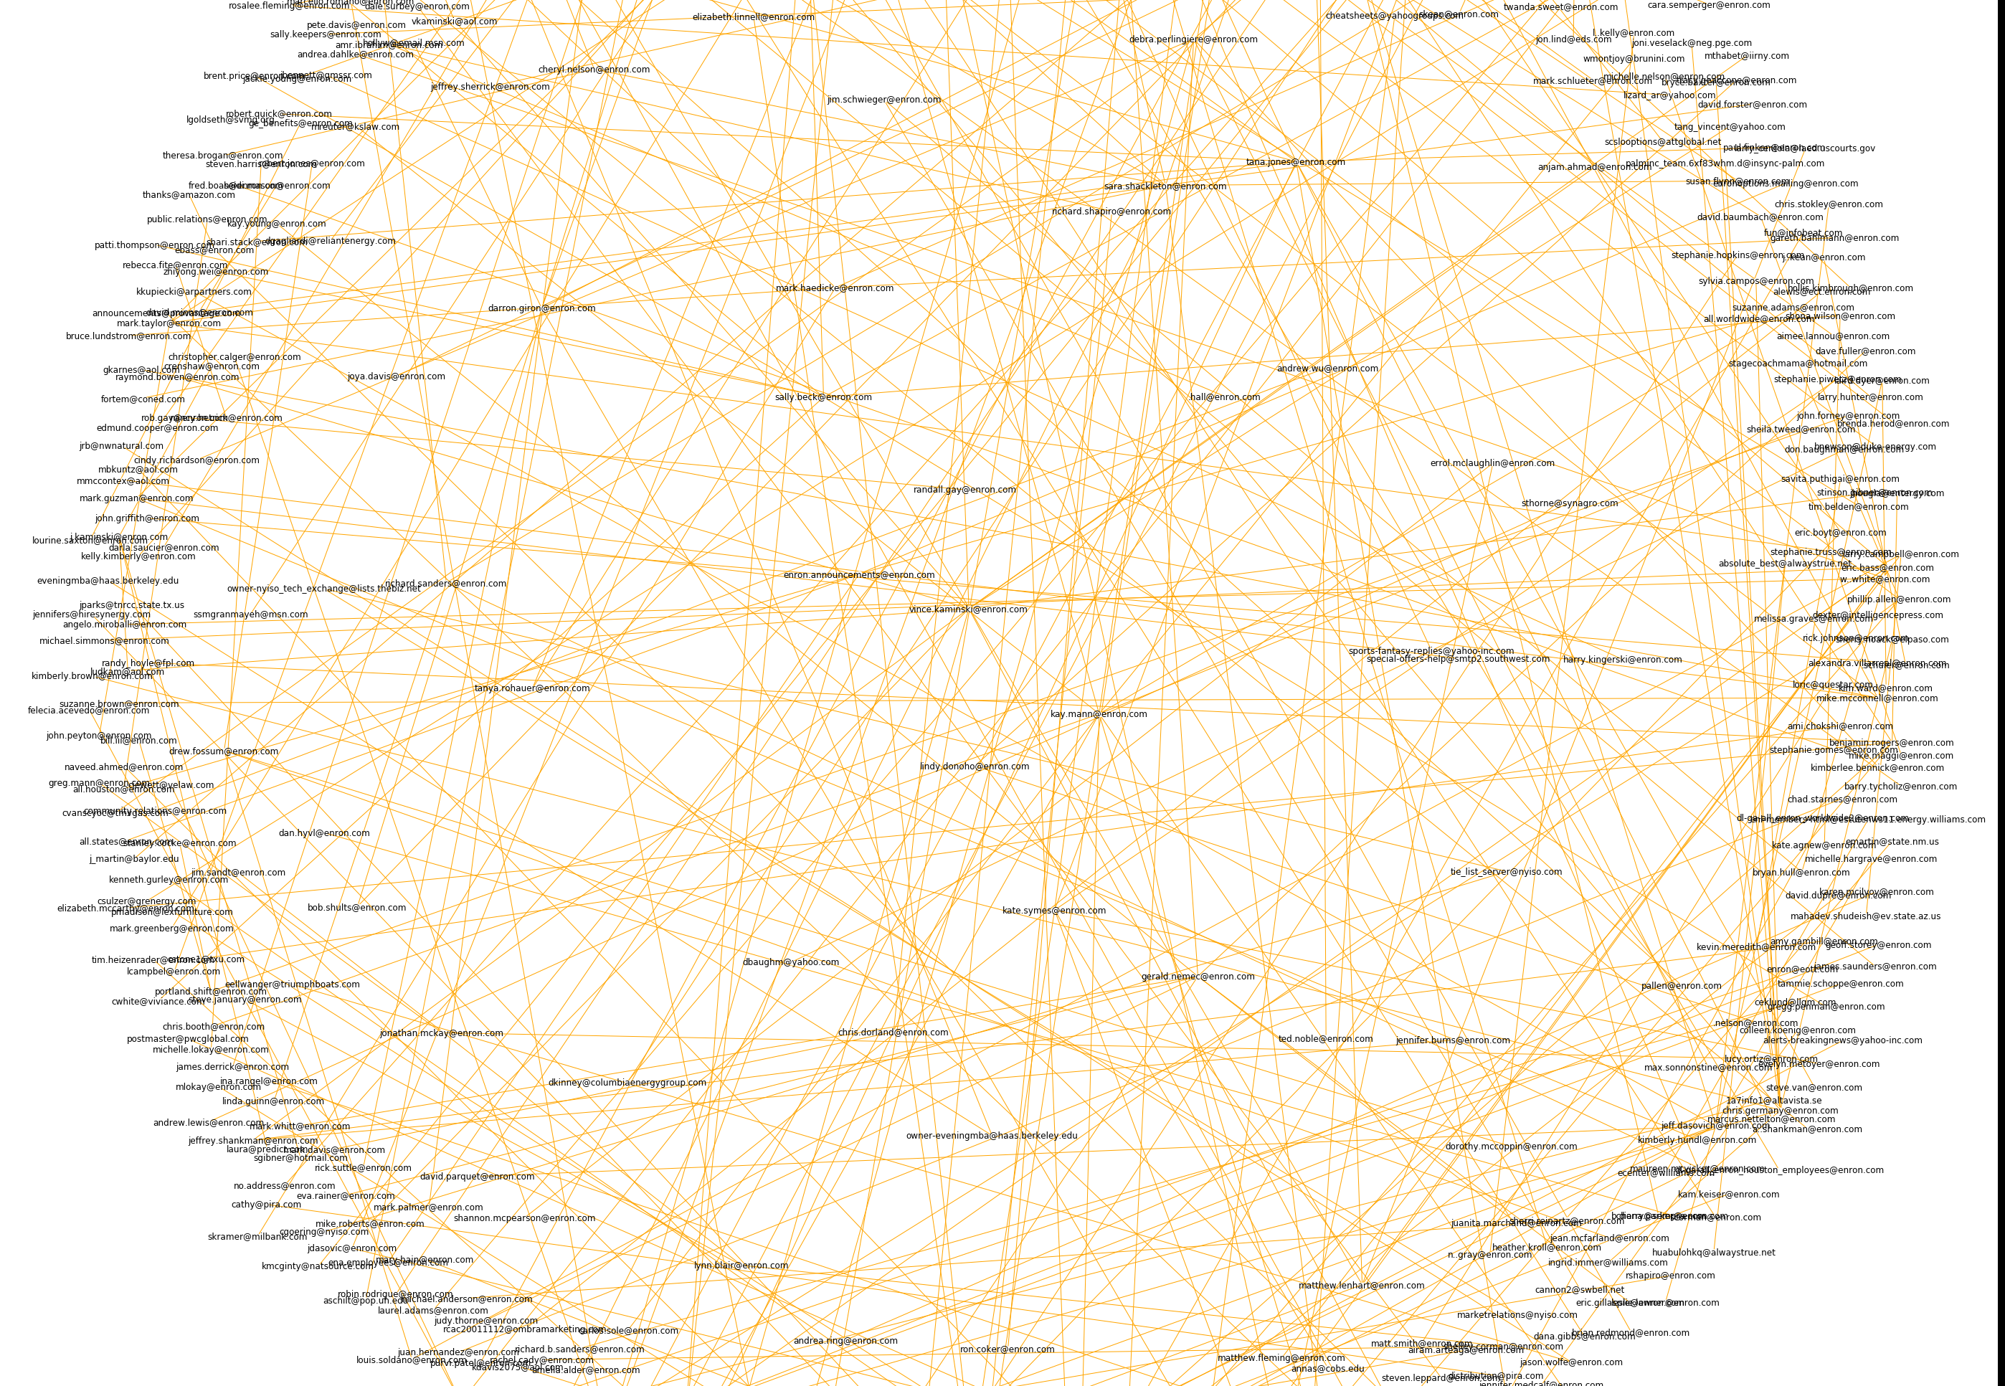

Slide 17
cONCLUSION
Due to the data size, we couldn’t complete an SNA on all the emails. Therefore, we did an SNA based on chunk size and a random sample.
The chunk size shows the SNA concentrating specifically on Philip Allen because Allen was the first name listed in the CSV
The random sample showed specific key players. However, the random sample of 500 was not validated and therefore, we cannot conclude the random sample adequately predicted key players.
However, the code worked!

